Slide 1
Excel Dashboard
-- Vrinda Store Sales Analysis 2022

Slide 2
OBJECTIVE
Vrinda wants to create an annual sales report for 2022.
So that Vrinda can understand their customers and grow more sales in 2023.

Slide 3
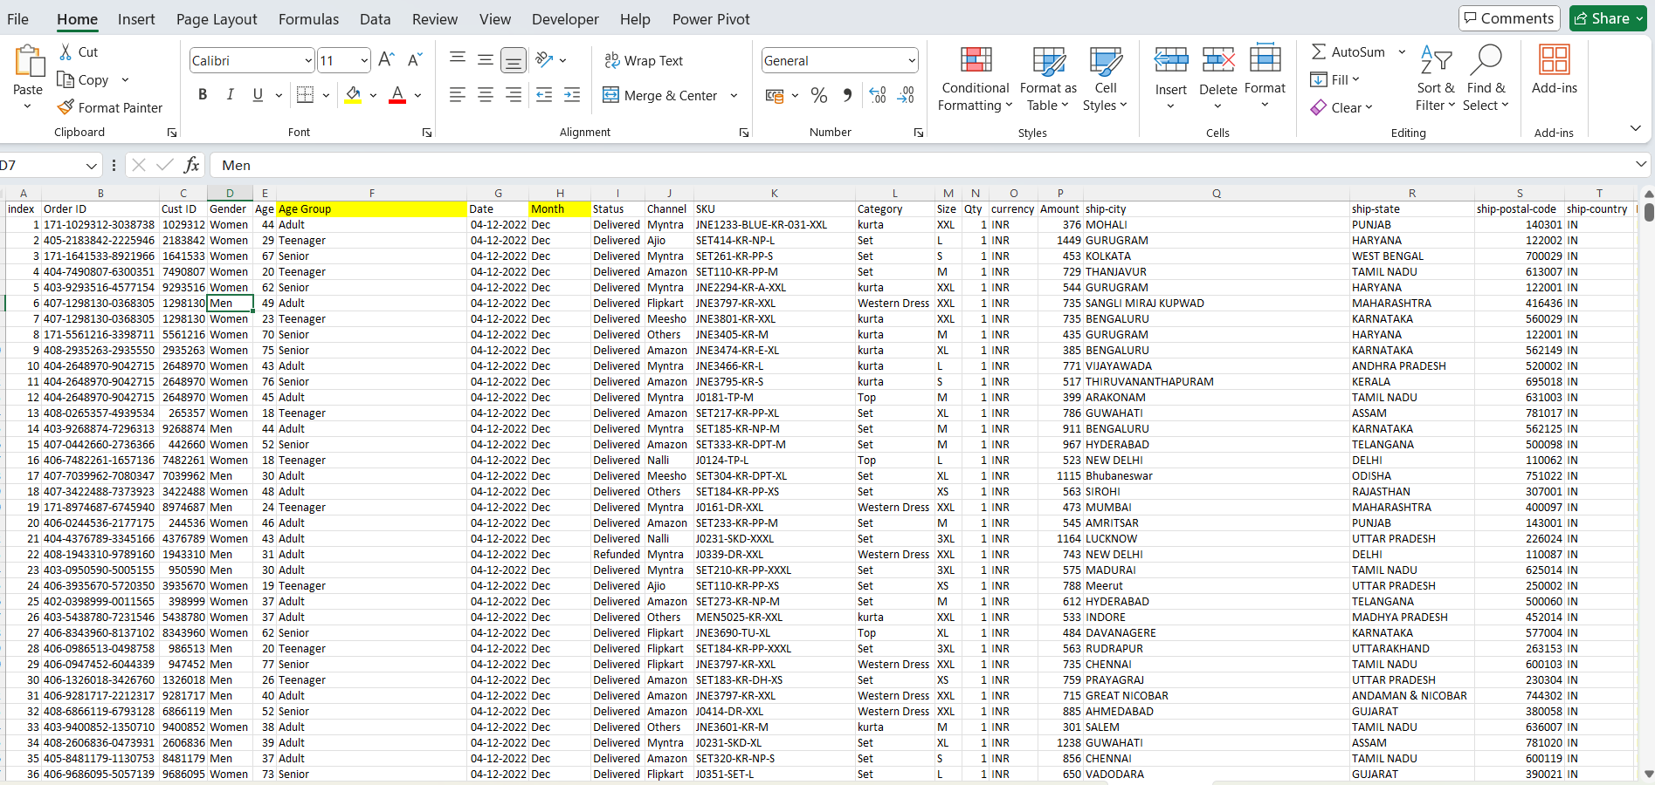
EXCEL DATASET
EXCEL FILE LINK

Slide 4
Questions
Compare the sales and orders using single chart ?
Which month got the highest sales and orders?
Who purchased more – men or women in 2022 ?
What are different order status in 2022 ?
List top 10 states contrubiting to the sales ?
Relation between age and gender based on number of orders ?
Which channel is contributing to maximum sales ?
Highest selling category ?

Slide 5
INSIGHTS AND CONCLUSION
Women are most likely to buy compared to men (~ 65%)
Maharashtra, Karnataka and Uttar Pradesh are the top 3 states (~ 35%)
Adult age group (30-49 yrs) is max contributing (~ 50%)
Amazon, Flipkart and Myntra channels are max contributing (~80%)
→ Conclusion :
Target women customers of age group (30-49 yrs) living in Maharashtra,Karnataka and Uttar Pradesh by showing ads/offers/coupons available on Amazon, Flipkart and Myntra

